Slide 1
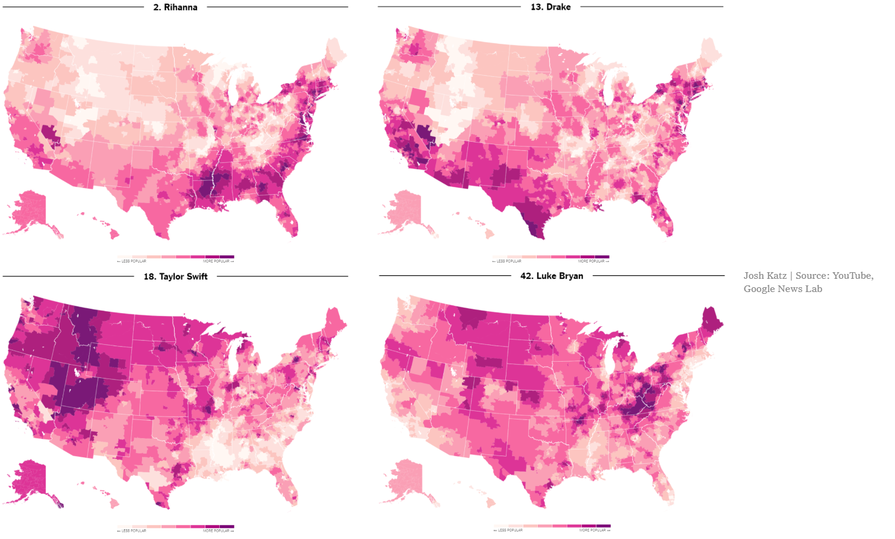
Detailed map reveal where Rihanna, Drake, Taylor Swift and Luke Bryan are listened the most

Slide 2
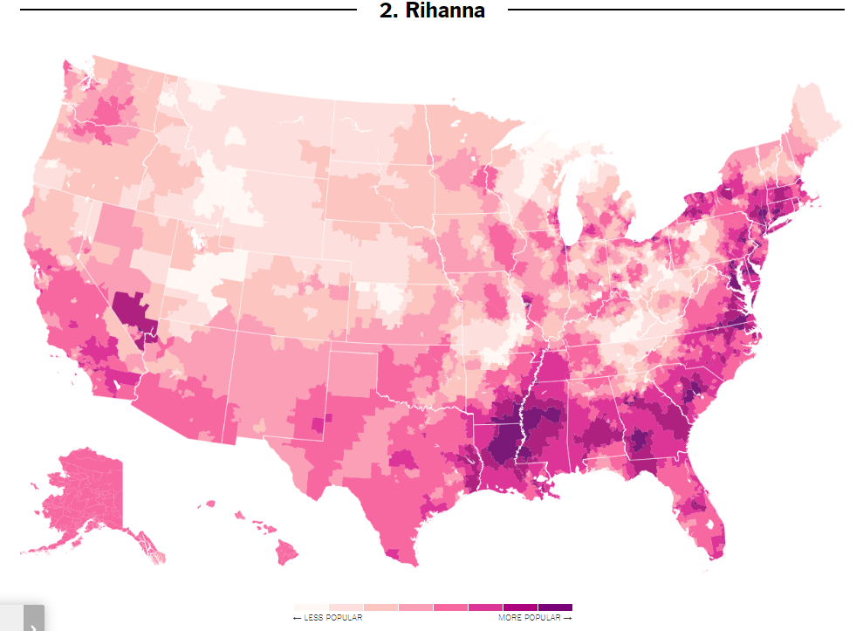
Montana
Idaho
Massachusetts
Wyoming
Connecticut
Utah
Maryland
Kentucky
Virginia
California
North Carolina
South Carolina
Georgia
Louisiana
Alabama
Mississippi
Florida

Slide 3
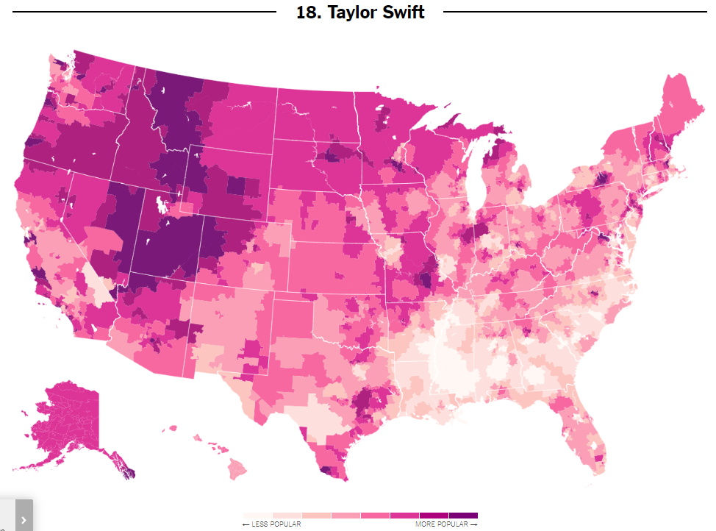
Montana
Oregon
Idaho
Wyoming
Nevada
Utah
Georgia
Louisiana
Alabama
Mississippi

Slide 4
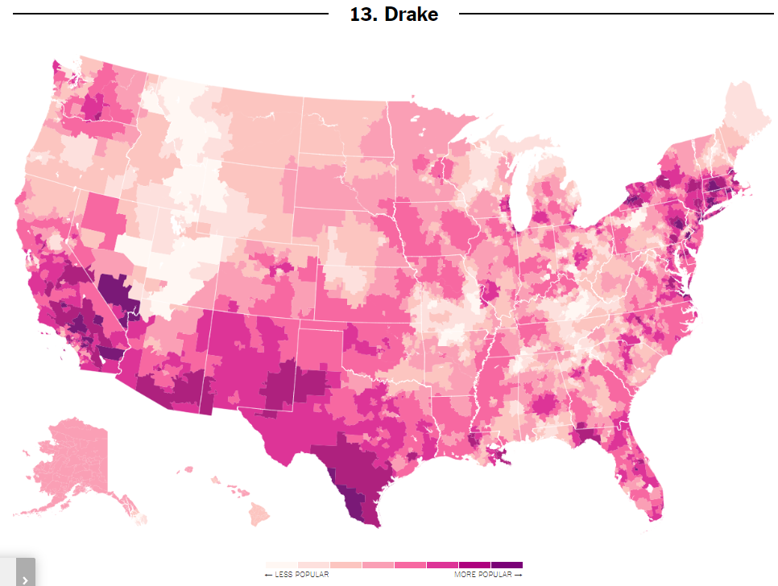

Montana
Massachusetts
Wyoming
Connecticut
Utah
California
Kentucky
Arizona
New Mexico
Texas

Slide 5
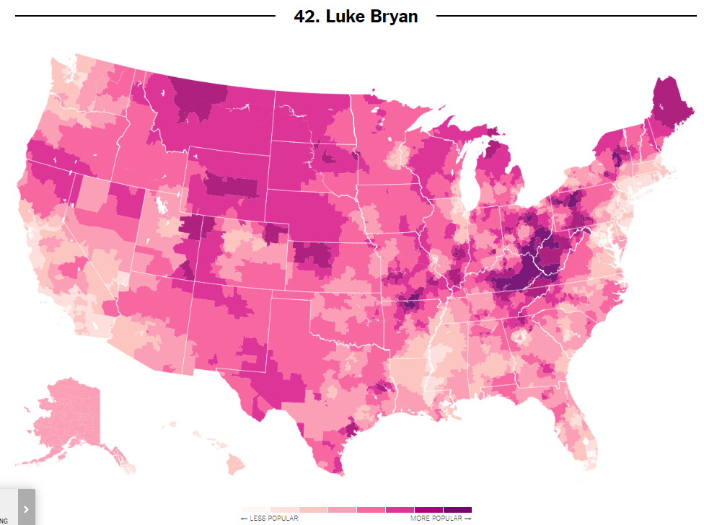
Maine
Montana
Wyoming
Connecticut
Kentucky
West Virginia
California
Mississippi

Slide 6
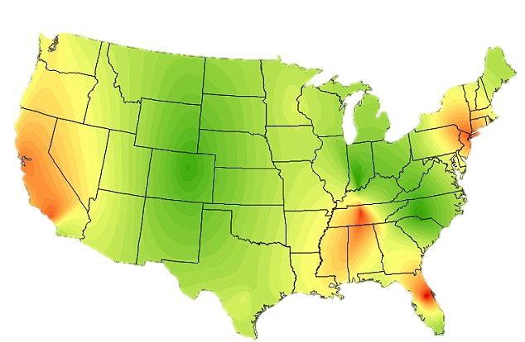
Repartition of Rhythm & Blues music
https://www.dailymail.co.uk/news/article-2609009/

Slide 7
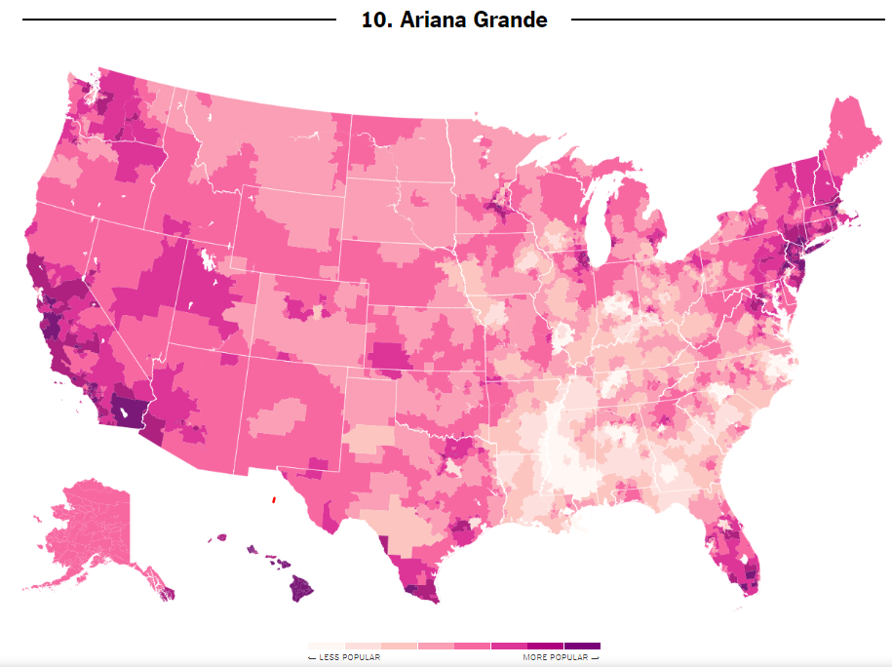
Massachusetts
Connecticut
California
Florida

Slide 8
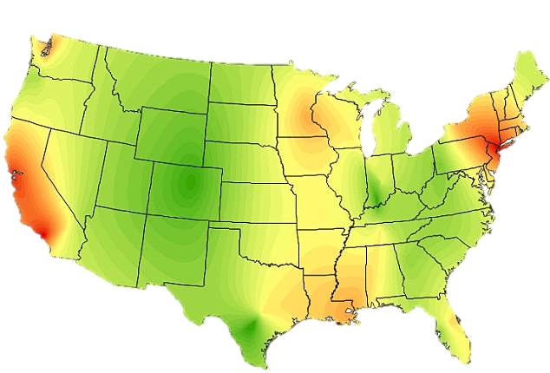
Repartition of Rap & Hip-Hop
https://www.dailymail.co.uk/news/article-2609009/

Slide 9
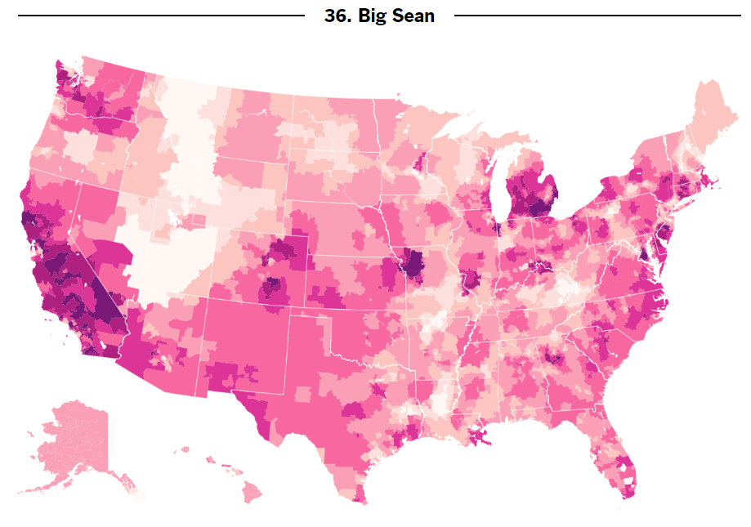
New York
Michigan
California

Slide 10
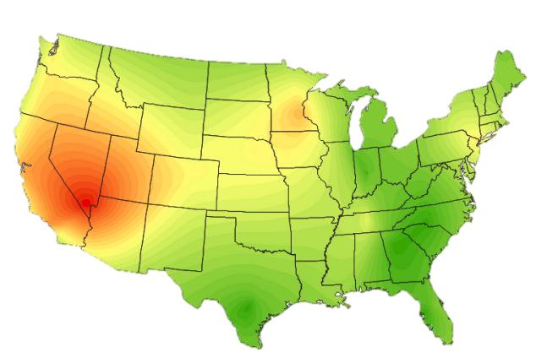
Repartition of Folk music
https://www.dailymail.co.uk/news/article-2609009/

Slide 11
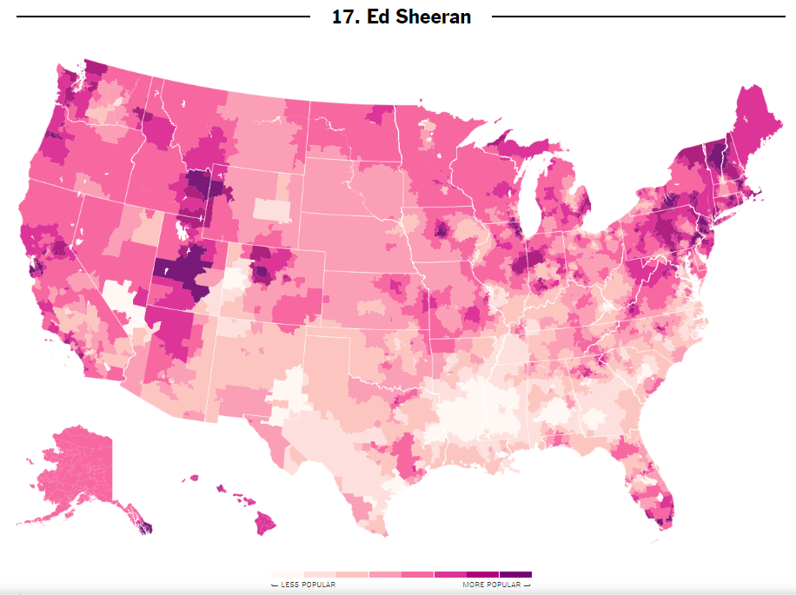
New York
Maine
Idaho
Utah

Slide 12
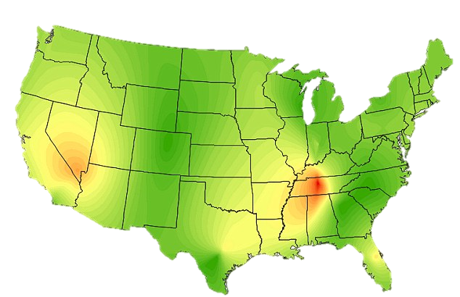
Repartition of Country music
https://www.dailymail.co.uk/news/article-2609009/

Slide 13
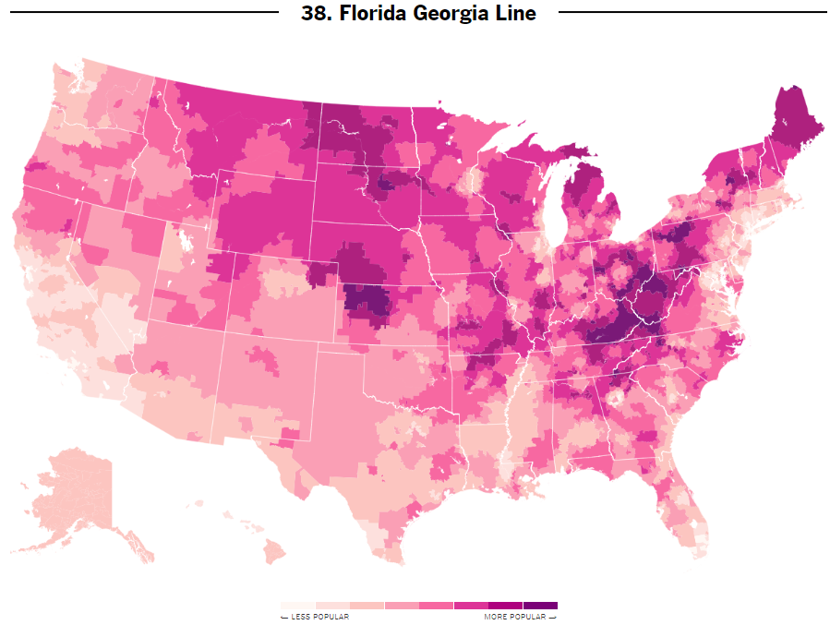
Wyoming
Kentucky

Slide 14

Thanks for listening

